Slide 1
Lenovo DCG Elevate Program
EMEA Channels | April 2021

Slide 2
Elevate Program Summary
Quarterly incentive program rewarding growth
Self-enrolment for all Lenovo DCG Authorized tier resellers
2 target groups to choose at the time of enrolment (Base and Top)
Guaranteed rebate for meeting Band A target
Ability to earn up to Band E rebate from each group
Enrollment period open until end of Month 2
Make/Miss incentive program with no rebate payment for results below the target
Sales data uploaded automatically every week based on distributor sales out reporting to Lenovo
Lenovo will automatically multiply the revenue for all accelerated products throughout the quarter
Final results will be available 4 weeks after eligible quarterly period
Resellers eligible for a rebate will be notified via email to submit their claim
Upon successful claim submission, payment will be made directly to reseller’s bank account
All Lenovo DCG products are included in the revenue measurement
Program exclusion: DCG Platinum, Gold and Silver tier resellers + any LSPP members

Slide 3
Elevate Target Groups

Slide 4
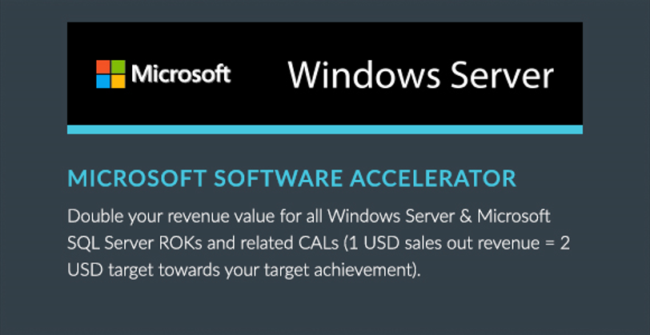
Elevate Accelerators
Accelerators throughout the year will help you exceed your target easier and earn bigger rebates.
How does it work?
Lenovo will automatically calculate and double your achieved sales for accelerated products to help you meet the program target and earn the highest possible reward.

Slide 5
How to enroll
Take these simple steps to become part of Lenovo DCG Elevate Program today:
- Register your company via www.lenovopartnerhub.com to become Lenovo DCG Authorized reseller
Already registered? Great! Sign in and navigate to Elevate program page
Select your target group, choose preferred distributor and accept program Terms and Conditions

Slide 6
FAQs
Do I have to register in the Elevate program every quarter?
Yes, as DCG Authorized Partner you will be provided by the new sales target for the eligible quarterly period. You must accept the program terms and your target each quarter to participate in the program.
When will I get my rebate?
After each quarterly period, typically within 4 weeks, Lenovo will reconcile all sales and email you your final Elevate rebate value to open the claim submission period. You have 30 days to submit your invoice for the total rebate amount from the date of the rebate notification.
Why do I need to select my Distributor?
While selecting your preferred distributor is optional, Lenovo strongly recommends to choose one in order to receive the best possible support in terms of DCG product portfolio, sales and technical guidance or the latest DCG promotions.
I need help with Elevate program, who do I contact?
Primary source of any information related to Elevate will be either your distributor or your local Lenovo DCG representative. For any Elevate technical queries, please use Contact Us form or contactus@lenovoelevate.com

