Slide 1
Welcome to LEAP
Understand how to get the most from your relationship with Lenovo and LEAP

Slide 2
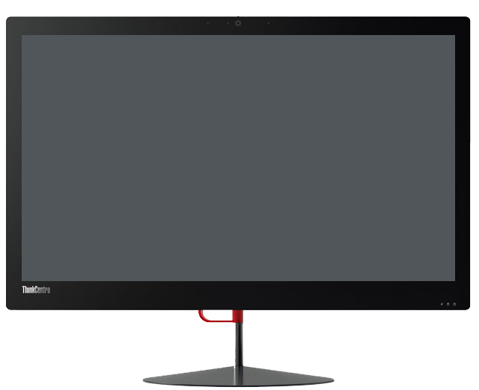
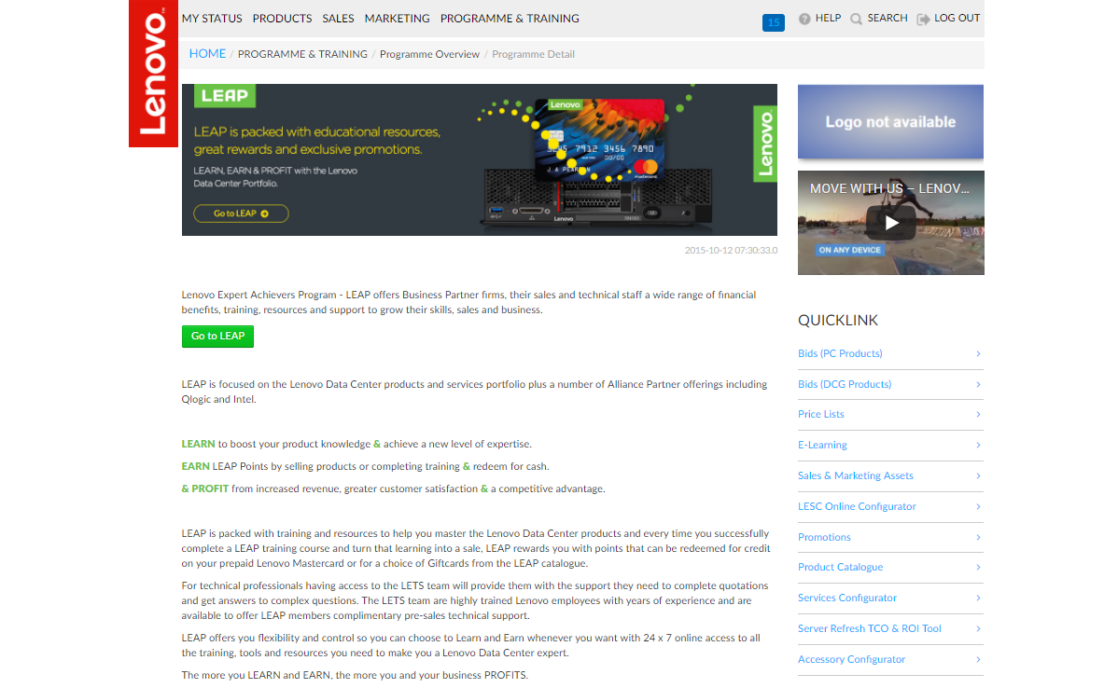
Access to LEAP
Access to LEAP is provided via your local Lenovo Business Partner portal. You’ll need to be registered and eligible to access the LEAP program.
Notes:
Need to update if this PPT is not circulated outside of LEAP.

Slide 3
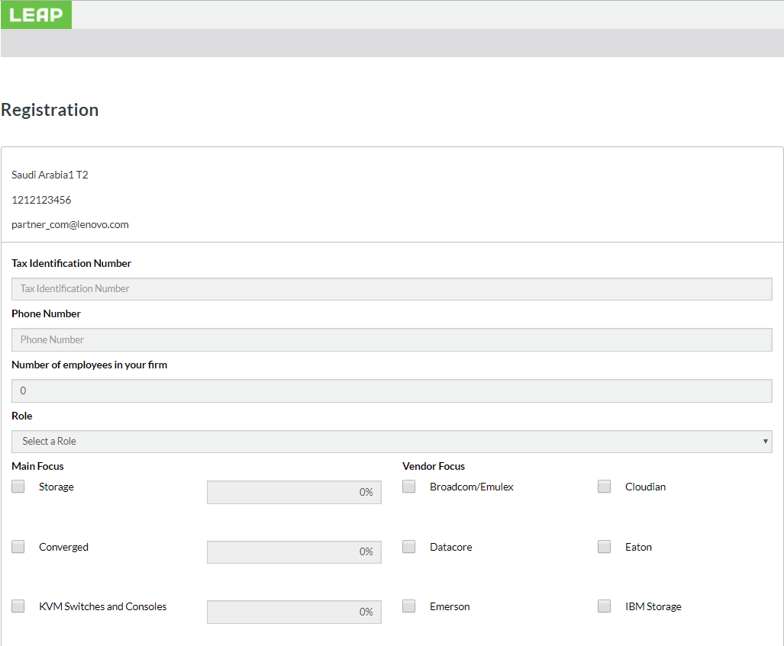
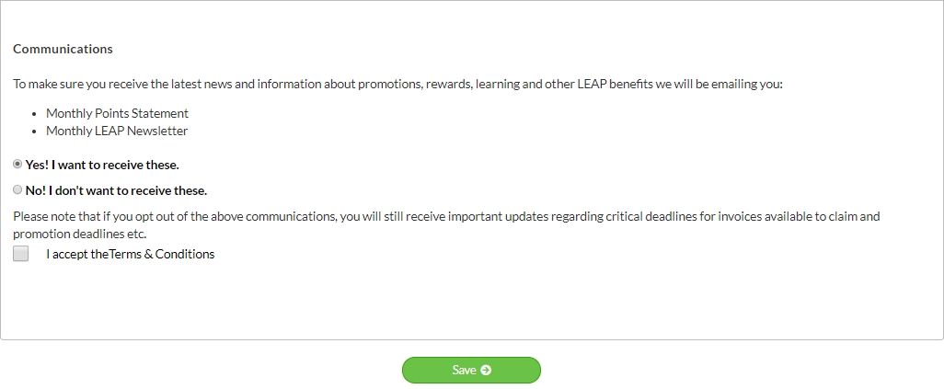
Your first step in LEAP
As a first step in our new LEAP, you will be asked to fill in a basic user registration form about your company and yourself like:
what Lenovo products or vendors you focus on
if you are sales or technical
you can subscribe to a LEAP newsletter
accept the program terms which replaces the previous LEAP agreement.

Slide 4
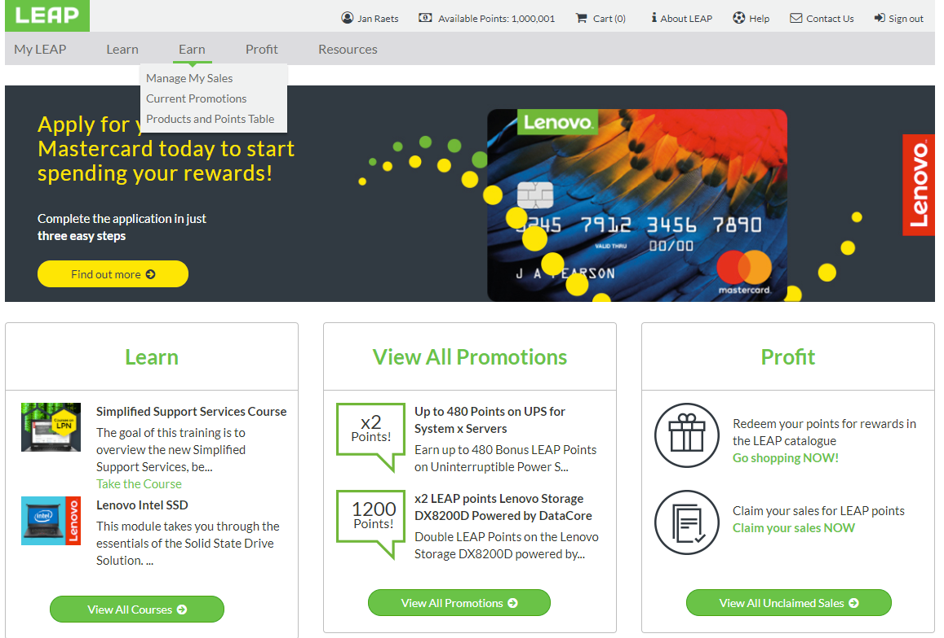
Navigating Around LEAP
LEAP has been redesigned to make it faster and easier for Lenovo Business Partners to access three key areas:
Learn – where you will find training courses to help you successfully sell and support DCG products
Earn – here you can claim your sales/invoices, understand which products qualify for LEAP points and view current promotions
Profit - topping up your Lenovo Mastercard or redeeming points is featured here.
From the homepage, you can access all of these areas from the menus and the featured content section which updates with the latest information on a regular basis.
Keeping you up to date is our priority!

Slide 5
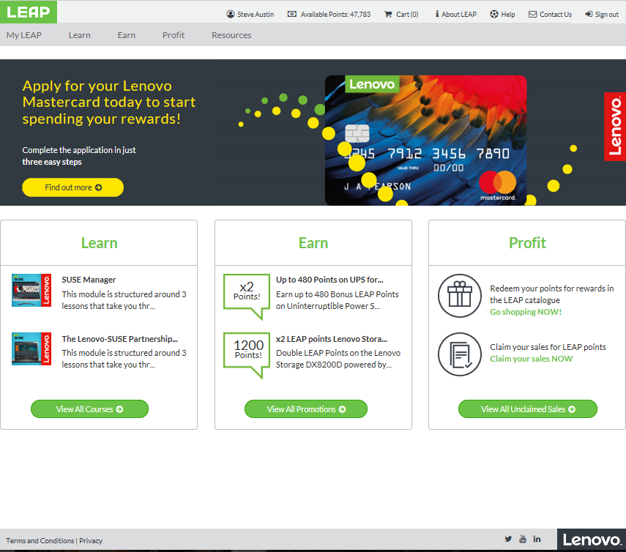
One Click Access Menus
For areas you don’t need to frequent as often as others, we have provide one click access from the top and bottom menus. From the top menu bar you can get access to:
About LEAP
Help
Contact Us
And return the LEAP homepage
From the bottom menu bar you can get access to:
Terms and Conditions
Privacy policy
Social media such as Twitter, YouTube and LinkedIn
And return to the Lenovo homepage

Slide 6
About LEAP
LEAP is a rewards program for sales and technical staff who are employed by Lenovo business partners.
LEAP provides a wealth of online tools and resources to help participants quickly boost their knowledge and become more successful when it comes to selling and supporting not only Lenovo products also key vendor products while earning LEAP Points which can redeemed for great rewards as a thank you from Lenovo!
There are two main ways participants can earn points - Learn and Earn and Sell and Earn.

Slide 7
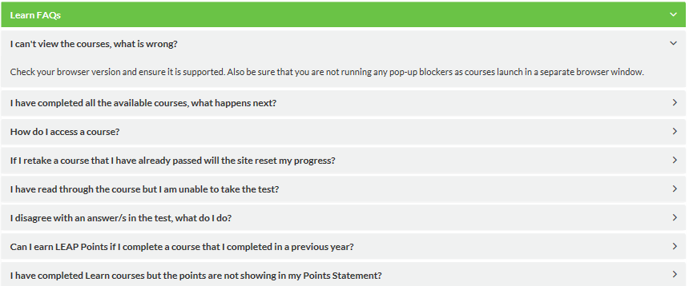
Help => FAQ
Help is only one click away!
The LEAP Help desk tracks the incoming questions from the LEAP community and then uses that information to compile lists of the most commonly asked questions for topics such as Learn, Sales and Rewards. Plus we have a General FAQ.
Use keyword search to fast track your way to the answer you need or you can always Contact Us.
Access FAQs from Help

Slide 8
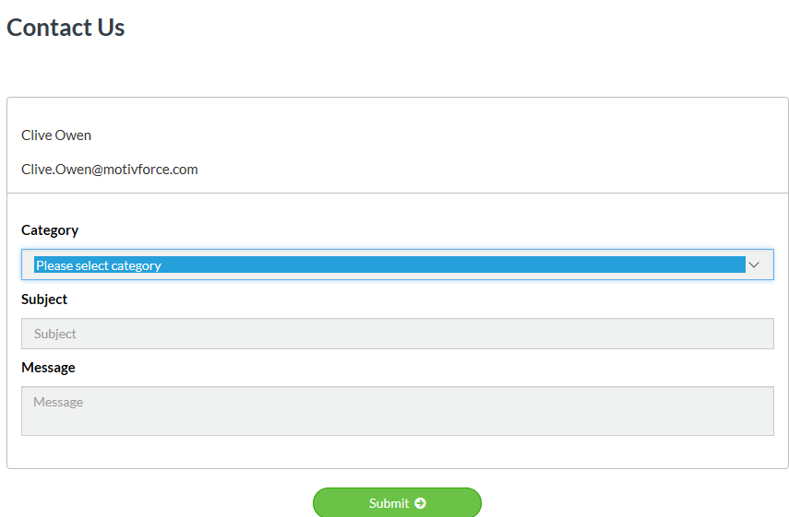
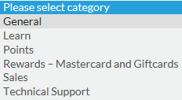
Contact Us
At any stage should you need assistance, just click
Contact Us
and fill in some basic information and a member of the team will be in contact with you within 48 hours.
Helping you get the most out of LEAP is our job!

Slide 9
My LEAP
LEAP is about your relationship with Lenovo, so it ensure you have all that information at your fingertips, we have introduced My LEAP:
My Profile
My Points Statement
My Redemptions
My Lenovo Mastercard
My Learning
My Certifications
From My LEAP you get a snapshot of your activity such as the number of courses completed, summary of your points, what of redemptions you made and your Lenovo Mastercard balance with quick click through for more information.
Start your LEAP day here!

Slide 10
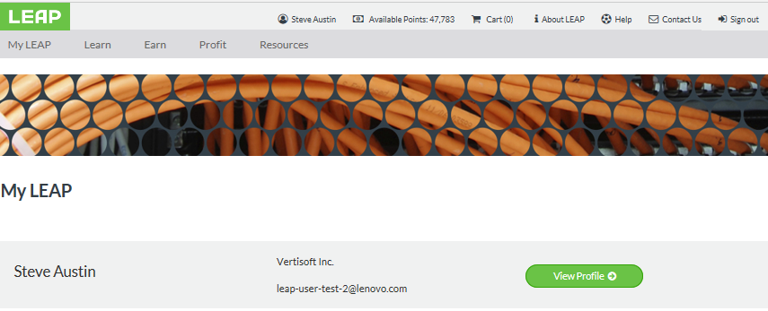
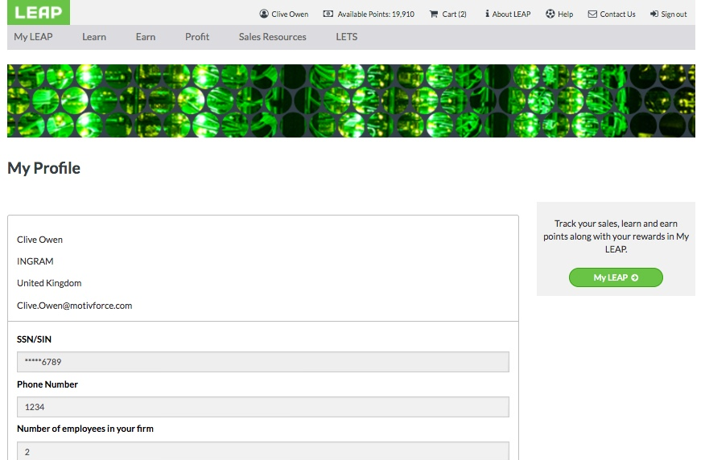
My Profile
My Profile draws information about you from your Lenovo Partner profile and your LEAP profile.
It is important to keep both sets of data up to date as we use this information to ensure we keep you update with topics that are relevant to your role and your focus on Lenovo products.

Slide 11
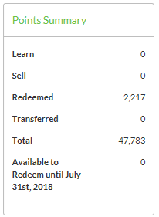
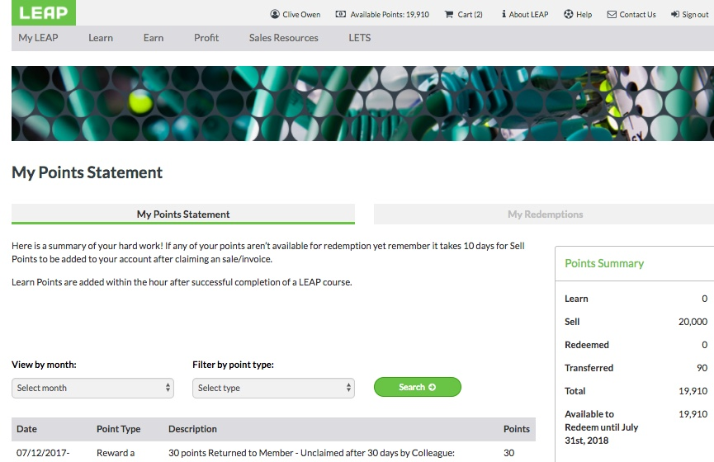
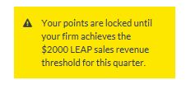
My Points Statement
Understanding your LEAP points is now even easier. We have arranged you points under the following categories:
Learn
Sell
Redeemed
Transferred
Also featured on your Points Statement is the status of the LEAP program criteria, remember before you can redeem points, you or your firm must have completed the following:
Completion of two (2) mandatory training courses – Yearly
Firm revenue threshold - Yearly

Slide 12
My Lenovo Mastercard
Do you have your Lenovo Mastercard yet?
To obtain your Mastercard you will need to complete the application process which is a simple three step process.
And then you can cash in your LEAP points for reloads your Mastercard.
Earn and Profit!

Slide 13
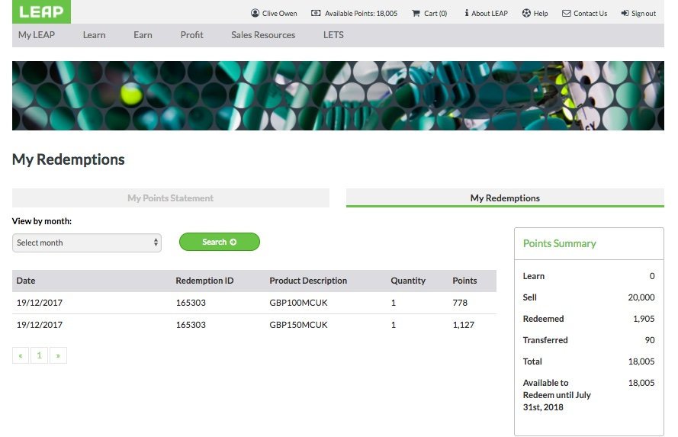
My Redemptions
Stay on top of your point usage with My Redemptions.
My Redemptions gives you a snapshot of how you are spending your LEAP points.
Detailed information on how many LEAP points you have redeemed and if that was a Branded E voucher or cash credits onto your Lenovo LEAP Mastercard.

Slide 14
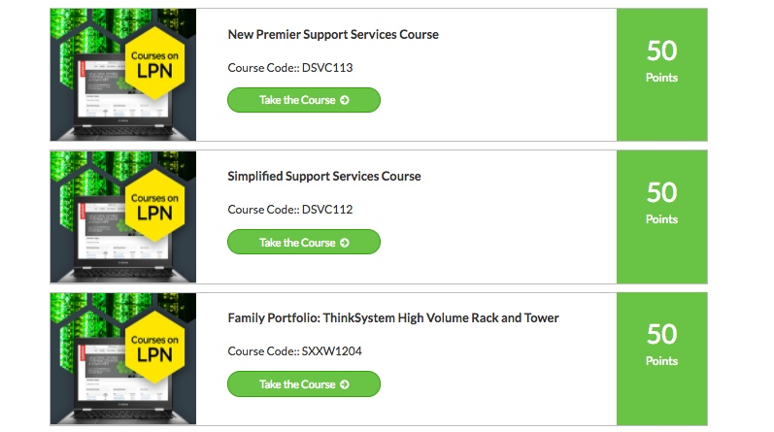
My Learning => Learn
The more you understand about the products you sell and support, the more successful you will be.
Lenovo wants to set you up for success so on top of the 2 mandatory courses, you have a wealth of training courses available to you.
LEAP points are allocated when you successfully achieve an 80% pass rate within 3 attempts.
Learn, Earn and Profit!
Access training courses from My Learning or the Learn menu

Slide 15
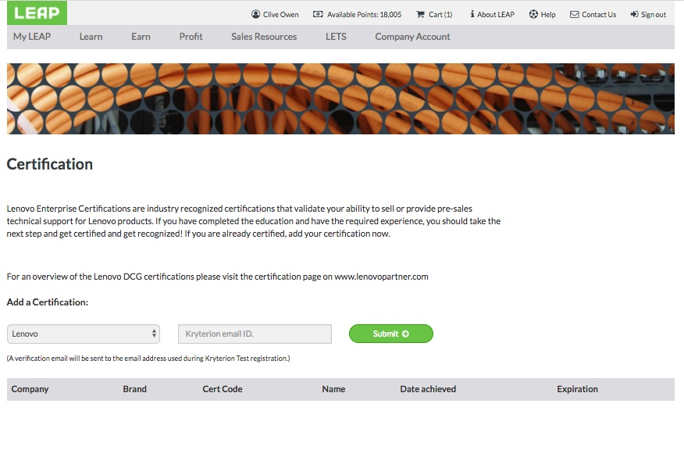
My Certifications
Lenovo Enterprise Certifications are industry recognised certifications that validate your ability to sell or provide pre-sales technical support for Lenovo products.
If you have completed the education and have the required experience, you should take the next step and get certified and get recognized! If you are already certified, just click Add a Certification.

Slide 16
Earn - Manage My Sales
From Manage My Sales you can view all of the invoices/sales submitted for your firm and perform 4 key actions from one single page:
View the details of all invoices including who claimed a invoice
Claim a invoice and receive the points allocation to that sale
Unclaim a invoice to return it and the allocated points back to the invoice pool for claiming by the rightful owner
Search for an invoice using keywords such as your customer’s details or utilise the “Missing Invoice” option and the LEAP team will make contact with you
Make sure you watch the step by step guide to Manage My Sales.

Slide 17
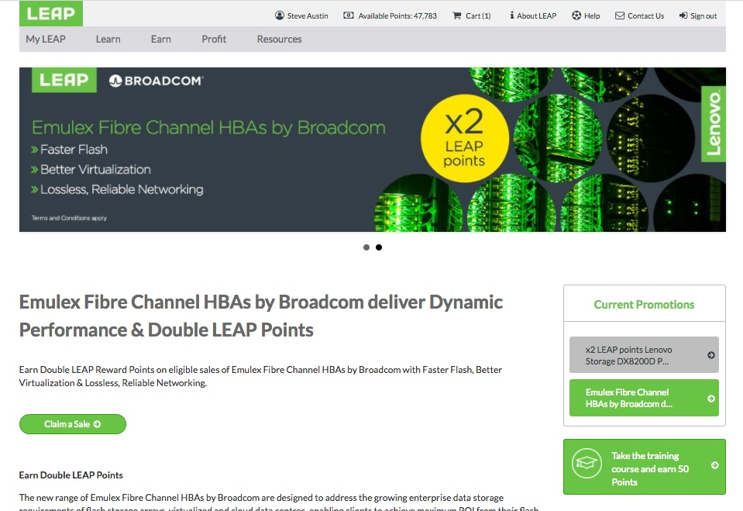
Earn - Current Promotions
Promotions are a great way to increase your points earning in LEAP. Check the ‘Current Promotions’ in the Earn section of LEAP to stay ahead of all the latest points earning opportunities.
Earn points on Lenovo Alliance Partner products and well as the Lenovo Data Center Portfolio.

Slide 18
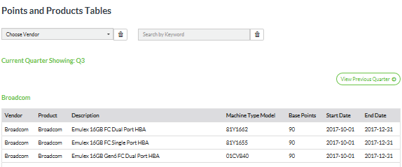
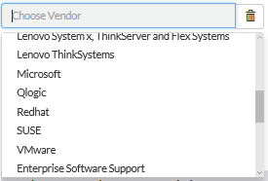
Earn - Products and Points Table
What products qualify for valuable LEAP points?
Selected DCG products qualify for LEAP points, and they are updated quarterly at a minimum. Also Lenovo Alliance partner products such as Red Hat, Intel, QLogic and Microsoft.
From the Products and Points Table list you can see all Lenovo and partner products and the number of points allocated to a particular product.
With LEAP products there are two types of point to earn, Base points and Bonus points. Bonus points can change and are subject to promotional periods, so keep track of your sales claims and don’t lose out.

Slide 19
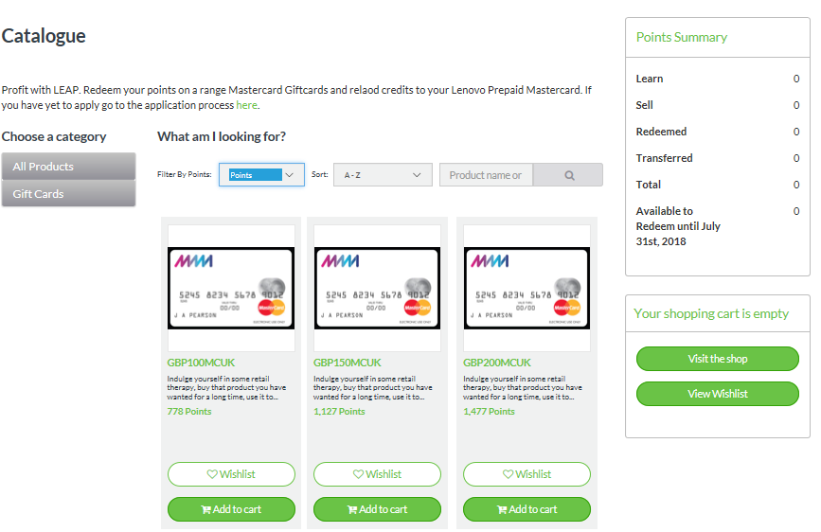
Profit - Catalogue
Now the fun starts!
You have two options available to you when it comes to spending your LEAP points.
Either redeem your points on a range E Vouchers, Giftcards or reload credits to your Lenovo LEAP Prepaid Mastercard.
Regardless of which option you prefer, its simple to redeem your points for great rewards.
The Lenovo Prepaid Mastercard works like a normal credit card, apply, activate and use in 35 million outlets across the globe.
We hope you ENJOY your rewards!

Slide 20
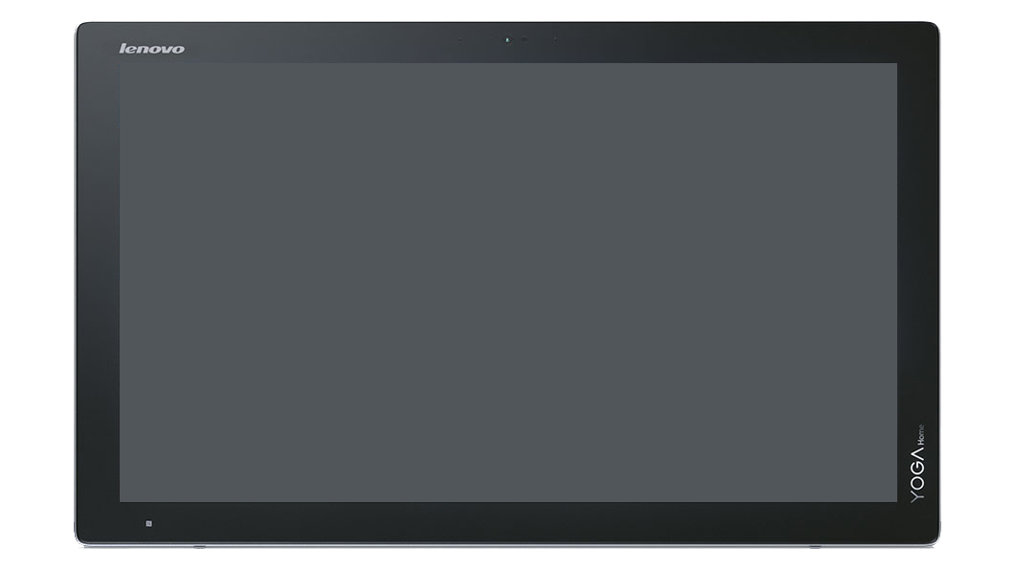
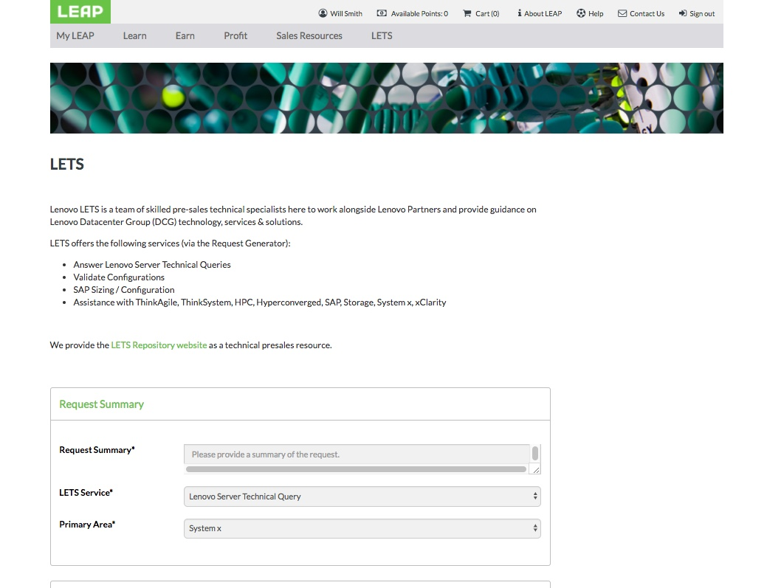
Lenovo Enterprise Technical Support (LETS)
LEAP has Sales and Technical Professionals.
Resources for our Technical Professionals are featured under the LETS (Lenovo Enterprise Technical Support) menu and fall into two areas:
Repository – Website loaded with technical pre-sales resources.
Request Generator – Get answers to technical questions, validate configurations and SAP sizing and get assistance with ThinkAgile, ThinkSystem, HPC, Hyperconverged, SAP, Storage, System x and xClarity
The LETS team are highly trained Lenovo employees with years of experience and are there to offer LEAP members quality pre-sales technical support.
The LETS team are highly trained Lenovo employees with years of experience and are there to offer LEAP members quality pre-sales technical support.

Slide 21
Thank you and we look forward to rewarding you!

